Slide 1

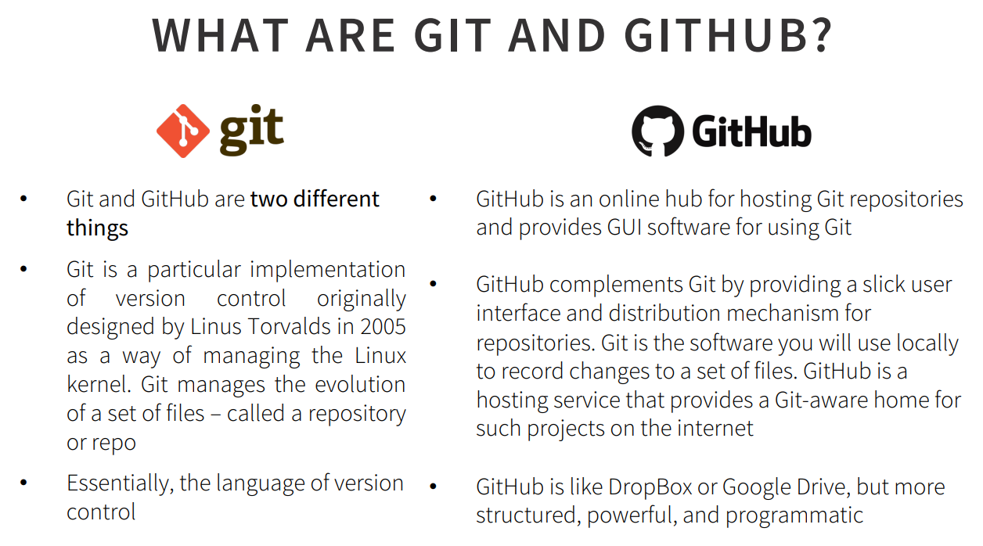
ADDITIONAL RESOURCES
education.github.com/pack → Learn to ship software like a pro
Mardown Cheatsheet: https://github.com/adam-p/markdown-here/wiki/Markdown-Here-Cheatsheet
Interactive git tutorial: https://try.github.io/levels/1/challenges/1
Visual/interactive cheatsheet: http://ndpsoftware.com/git-cheatsheet.html

Slide 2
Basic workflow
git –version : to control git
git init : create git project in existing directory
Pwd: Shows in detail which project you are on
cd .. → Takes to the file 1 above
cd desktop → takes you to the desktop
clear → clear git page
mkdir filename→Creating a folder
mkdir app → Create a folder named app
touch filename → create file
ls→ List files ,folders
git add : Add files to be committed with :
git commit –m ‘’ commit msg’’ : create commit
git fetch <remotename> :catch file
Git pull: pull changes from remote repository made by others
git status : checks which files are set up to be added/updated
git merge mybranch :merges multiple branches together
git config --global alias.st status / :youcan value
git mv filename newfoldername :move file
git reset HEAD filename :get back file
git log : shows all changed
git checkout -- <filename> : brings the deleted one
git rm <filename> : Delete file,folder
git diff : Shows all changes made
.gitignore : Write what you want to hide in this file.
git remote rm <remotename> :remove filename
Link → https://github.com/github/gitig

Slide 3
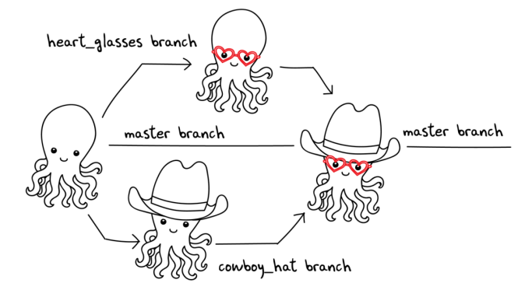
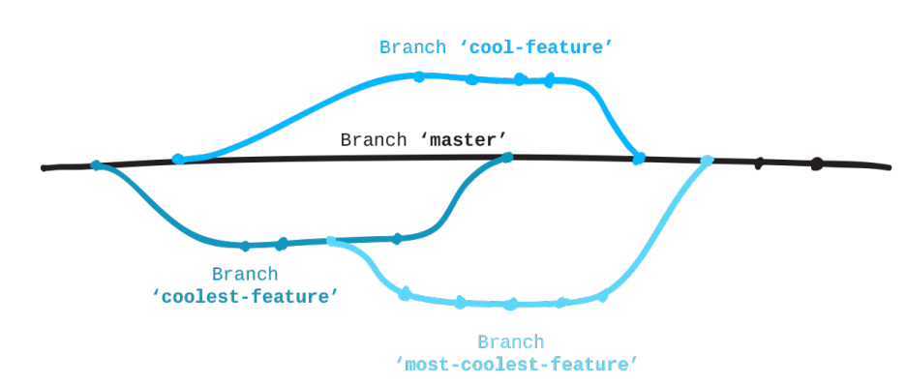
Branches are actually just a pointer to these commits
List all branches in the project →git branch
Create a new branch →git branch<branchname>
Switch to a branch →git checkout<branchname>
Create and immediately switch →git checkout –b<branchname>
Delete a branch → git branch –d <branchname>

Slide 4
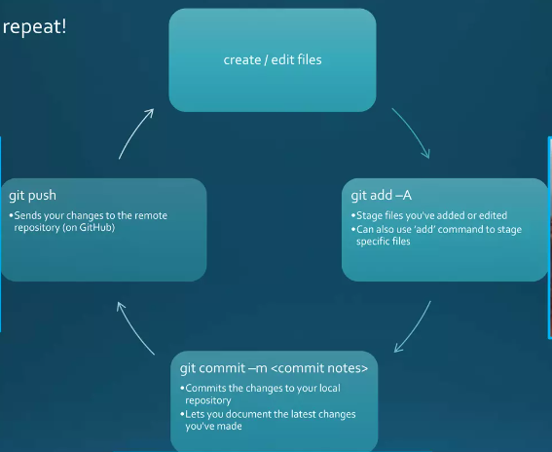
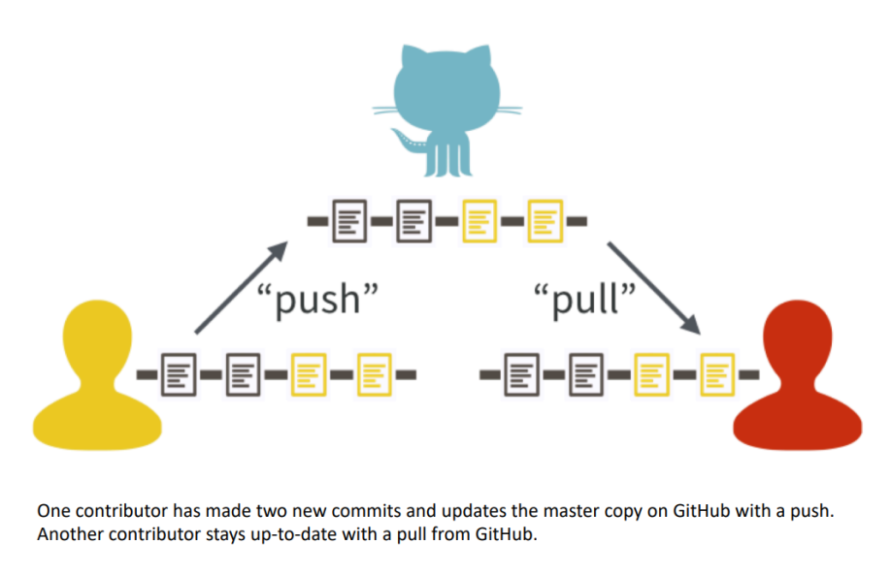
Pushing and fetching
git push <remotename> <branchname> sends your code in the branch up to the remote
The process of adding your local changes to a remote repo is called pushing changes
The process of downloading commits that don’t exist on your machine from a remote server is called pulling changes

Slide 5
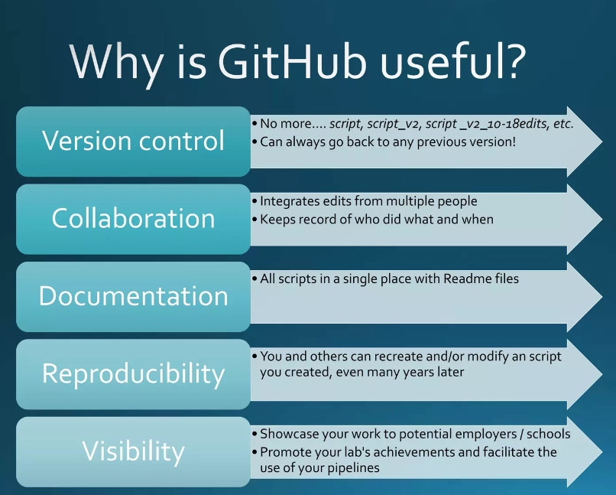
GithuB
Repository
Readme
Branch
Push
Pull requests
Issues
Authenticating to Github
https://help.github.com/articles/generating-ssh-keys

Slide 6
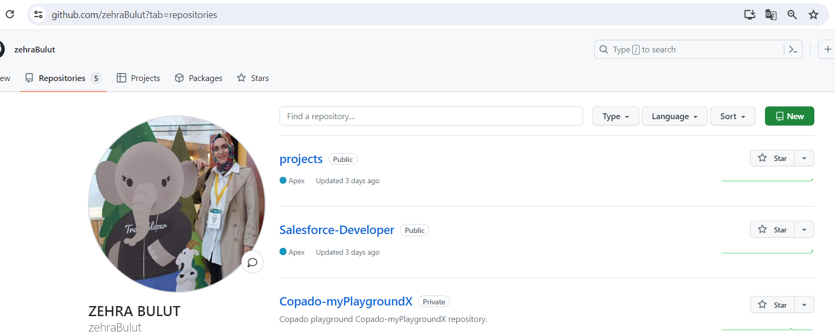
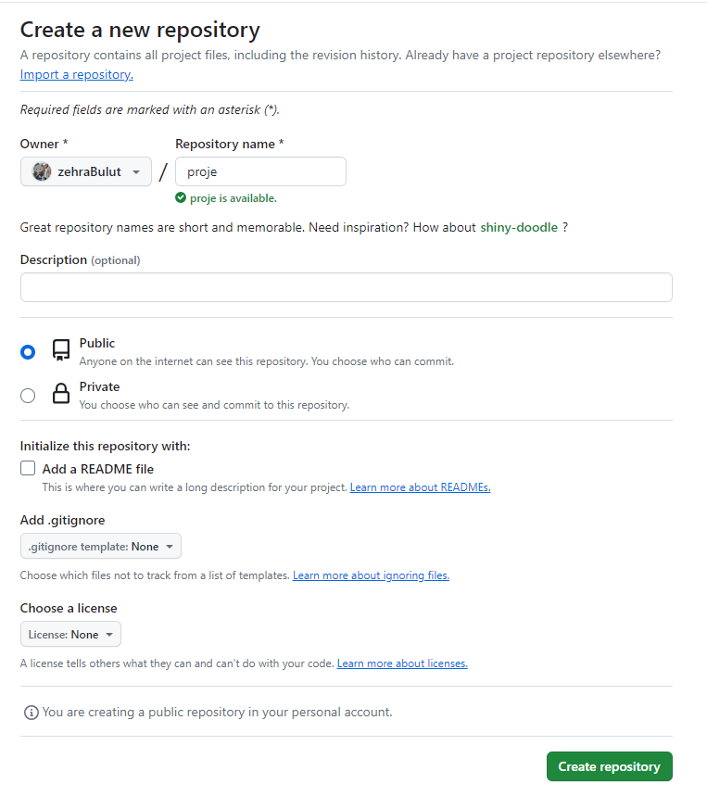
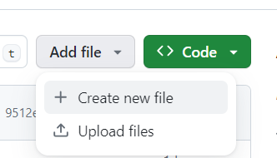
Repo:
This a collection of all your files and the history of those files

Slide 7

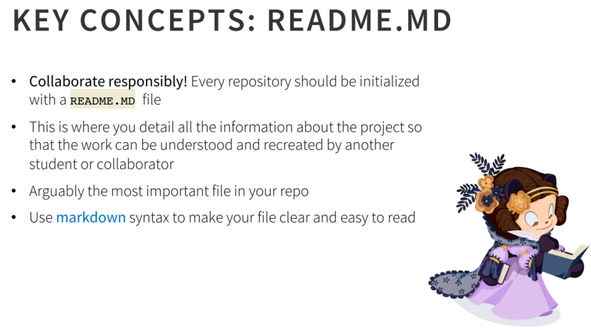
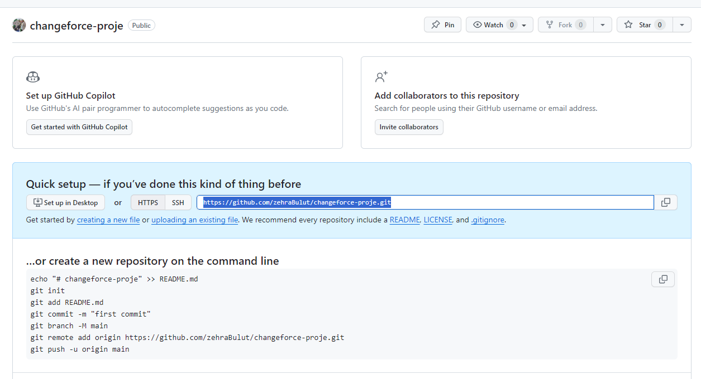

Slide 8
